Slide 1
Multiomics approach to study aging in C elegans
Introduction to Multiomics Data Integration and Visualisation
EBI - March 2020
Jacques Serizay
https://github.com/js2264/EBI_multiOmics_2020

Slide 2
What is aging?
Aging is a time-dependent functional decline that affects most living organisms. It is characterized by a progressive loss of physiological integrity, leading to impaired function and increased vulnerability to death.
López-Otı́n, Carlos, Maria A. Blasco, Linda Partridge, Manuel Serrano, and Guido Kroemer. 2013. “The Hallmarks of Aging.” Cell

Slide 3
What is aging?
Aging is a time-dependent functional decline that affects most living organisms. It is characterized by a progressive loss of physiological integrity, leading to impaired function and increased vulnerability to death.
López-Otı́n, Carlos, Maria A. Blasco, Linda Partridge, Manuel Serrano, and Guido Kroemer. 2013. “The Hallmarks of Aging.” Cell
But at which level???

Slide 4
Aging is frequently considered to be a cellular process
Here, we have attempted to identify and categorize the cellular and molecular hallmarks of aging. We propose nine candidate hallmarks that are generally considered to contribute to the aging process and together determine the aging phenotype
López-Otı́n, Carlos, Maria A. Blasco, Linda Partridge, Manuel Serrano, and Guido Kroemer. 2013. “The Hallmarks of Aging.” Cell

Slide 5
But really, aging is a multi-scale biological process
Son, Heehwa G., Ozlem Altintas, Eun Ji E. Kim, Sujeong Kwon, and Seung-Jae V. Lee. 2019. “Age-dependent changes and biomarkers of aging in Caenorhabditis elegans.” Aging Cell

Slide 6
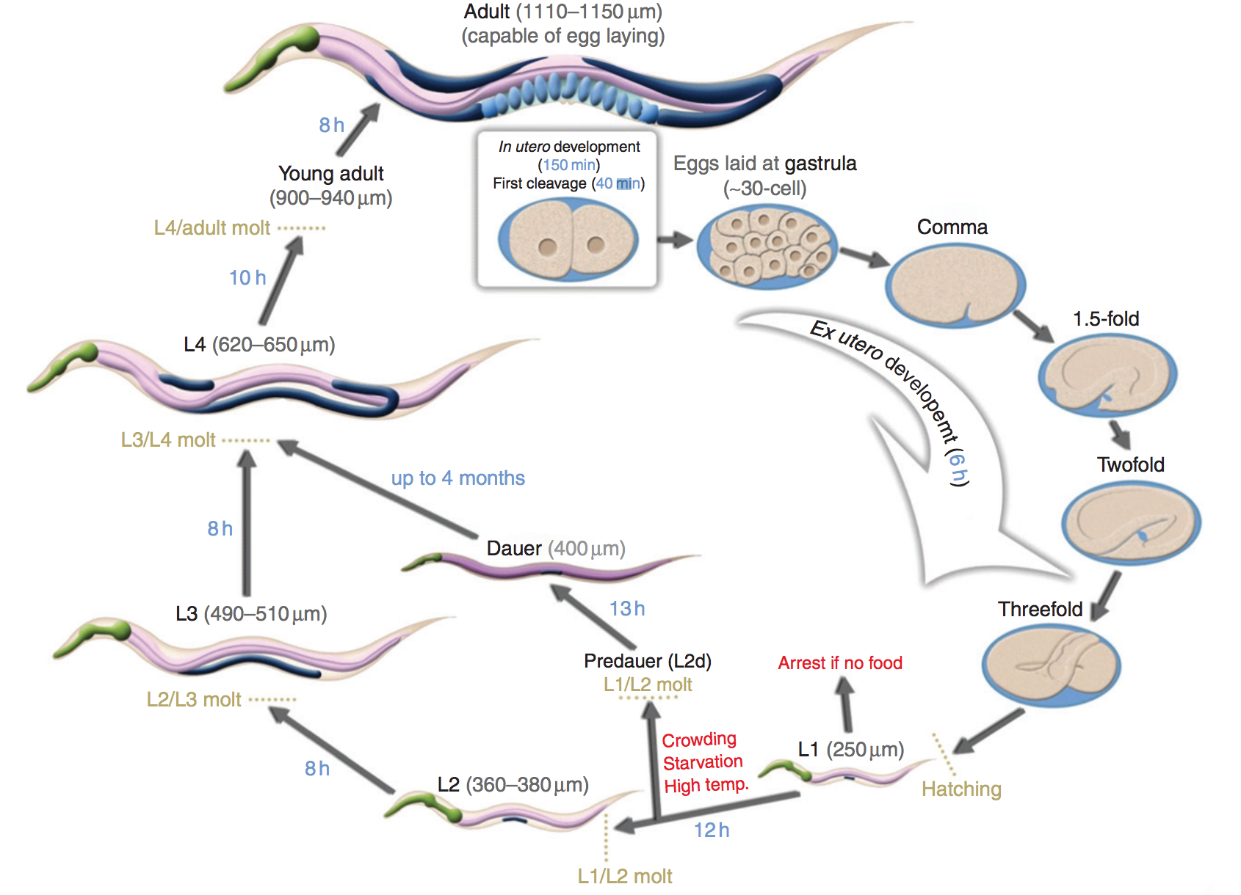
How to study aging at each scale?
Caenorhabditis elegans:
- It has a short life cycle (~ 21 days in normal conditions);
- Mutants can be easily generated and phenotypically screened for aging defects;
- Its genome has been fully sequenced and presents fundamental resemblances with that of more complex metazoans.

Slide 7
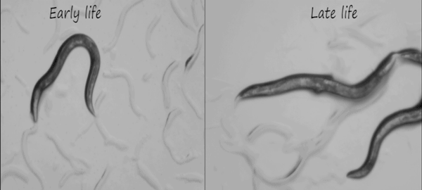
How to study aging at each scale?
Living for 20-25 days
Caenorhabditis elegans:
- It has a short life cycle (~ 21 days in normal conditions);
- Mutants can be easily generated and phenotypically screened for aging defects;
- Its genome has been fully sequenced and presents fundamental resemblances with that of more complex metazoans.
- It ages!!

Slide 8
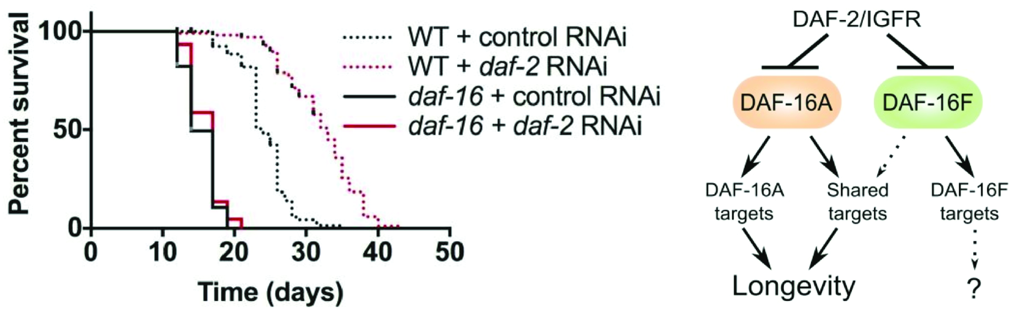
How to study aging at each scale?
Caenorhabditis elegans:
- It has a short life cycle (~ 21 days in normal conditions);
- Mutants can be easily generated and phenotypically screened for aging defects;
- Its genome has been fully sequenced and presents fundamental resemblances with that of more complex metazoans.
- It ages!!
- Longevity assays are easy to perform and very informative.

Slide 9
Aims of the project:
The goal of this study is to analyze aging-related perturbations in worm in a comprehensive manner to:
Identify the tissues undergoing important remodeling during aging;
Understand the molecular networks involved in aging.
More specifically, we would like to fulfill the following aims:
Find tissue-specific proteins and genes deregulated during aging;
Find their associations with known diseases;
Find potential targets for drug engineering

Slide 10
What you will do
Integrate multiple “omics” datasets together:
Proteomics
Transcriptomics
Epigenomics: chromatin accessibility and transcription factor chromatin immunoprecipitation
Learn some fundamental tools and visualization packages:
Handling genomic data in R (Bioconductor)
Gene ontology term enrichment analysis (gProfileR)
Aggregated genomic coverage plots (Seqplots)
Protein-protein interactions (STRING database)
DNA sequence analysis (MEME)
…
And converting IDs!!!!

Slide 11
What you will use (1)
Reinke, Aaron W, Raymond Mak, Emily R Troemel, and Eric J Ben. 2017.
“In Vivo Mapping of Tissue- and Subcellular-Specific Proteomes in Caenorhabditis Elegans.” Science Advances

Slide 12
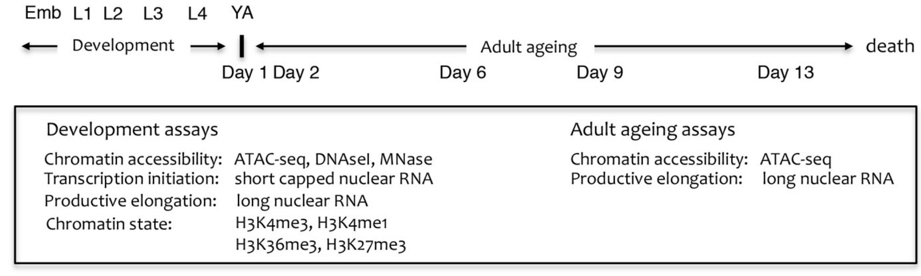
What you will use (2)
Jänes, Jürgen, Yan Dong, Michael Schoof, Jacques Serizay, Alex Appert, Chiara Cerrato, Carson Woodbury, et al. 2018. “Chromatin accessibility dynamics across C. elegans development and ageing.” eLife

Slide 13
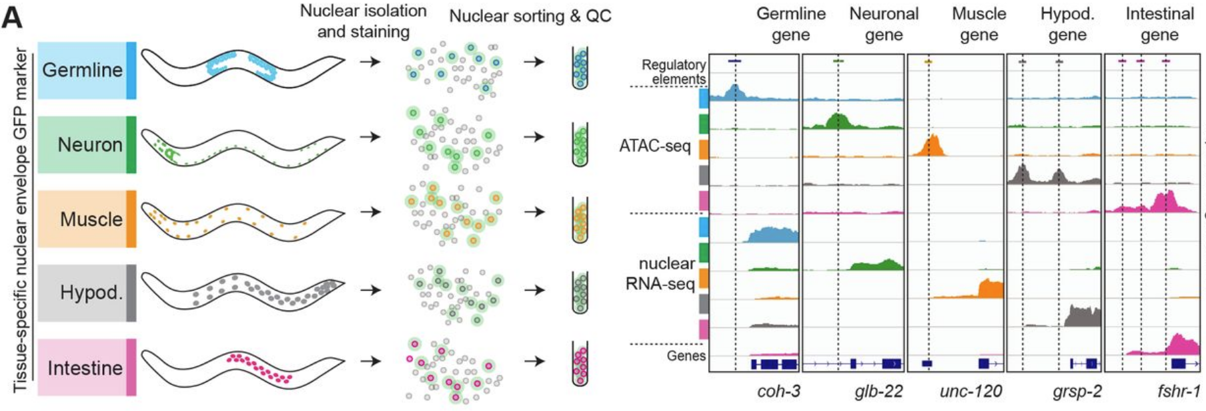
What you will use (3)
Jacques Serizay, Yan Dong, Jürgen Jänes, Michael Chesney, Chiara Cerrato, Julie Ahringer, 2020, “Tissue-specific profiling reveals distinctive regulatory architectures for ubiquitous, germline and somatic genes”, bioRxiv

Slide 14
What you will use (4)
modENCODE
modERN
https://www.encodeproject.org/

Slide 15
Resources
Project repository:
https://github.com/js2264/EBI_multiOmics_2020
Detailed introduction and guidelines:
https://js2264.github.io/EBI_multiOmics_2020/
References:
Reinke, Aaron W, Raymond Mak, Emily R Troemel, and Eric J Ben. 2017. “In Vivo Mapping of Tissue- and Subcellular-Specific Proteomes in Caenorhabditis Elegans.” Science Advances
Jänes, Jürgen, Yan Dong, Michael Schoof, Jacques Serizay, Alex Appert, Chiara Cerrato, Carson Woodbury, et al. 2018. “Chromatin accessibility dynamics across C. elegans development and ageing.” eLife
Jacques Serizay, Yan Dong, Jürgen Jänes, Michael Chesney, Chiara Cerrato, Julie Ahringer, 2020, “Tissue-specific profiling reveals distinctive regulatory architectures for ubiquitous, germline and somatic genes”, bioRxiv
https://www.encodeproject.org/

